Slide 1
Coffee_Chain_Sales
Internship Task 3- Dashboard Design

Slide 2
Contents
Dataset used
Objectives
Sales Trend
Sales and Profit by market
Total Sales Card and Total Profit Card
Dashboard

Slide 3
Dataset used
Kaggle Sales and Financial datasets were referred for the given task.
The dataset named “Coffee Chain Sales Analysis-
Exploring Coffee Chain Sales Data: Analyzing Sales Trends and Insights” was used.
The file was downloaded and extracted in a .csv format.

Slide 4
Objectives
Show how sales or profit has changed over time.
Compare sales and profit across different markets.
Display total sales and profit in a clear, concise way.
Assemble the Interactive Dashboard.

Slide 5
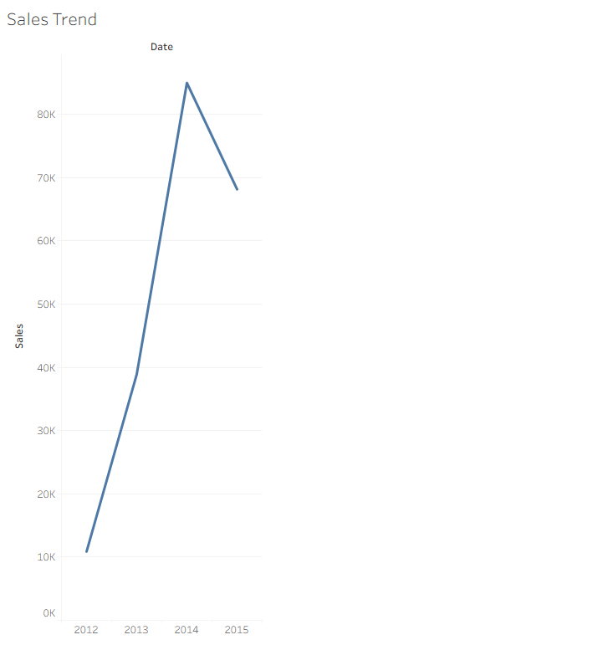
Sales Trends
Key Observations:
X-Axis (Horizontal): Represents the year, ranging from 2012 to 2015.
Y-Axis (Vertical): Represents the sales amount, with increments labeled in thousands (K), from 0K to 90K.
The sales trend:
2012: Sales start at a low point (~10K).
2013: Sharp increase to about 40K.
2014: Steep rise continues to a peak of about 85K.
2015: Sales drop down to around 68K.
Summary:
The chart depicts a strong upward trend in sales from 2012 to 2014, followed by a noticeable decline in 2015. This could suggest a potential peak in the business cycle or external factors influencing a drop in performance in 2015.

Slide 6
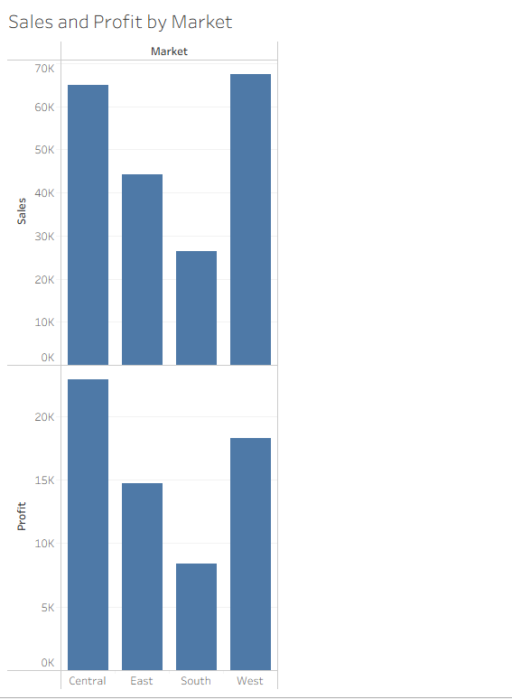
Sales and Profit by Market
Top Chart: Sales by Market
Y-Axis: Represents Sales (in units, up to 70K).
Observations:
West has the highest sales (just under 70K).
Central follows closely behind (around 65K).
East shows moderate sales (~45K).
South has the lowest sales (under 30K).
Bottom Chart: Profit by Market
Y-Axis: Represents Profit (in units, up to 25K).
Observations:
Central is the most profitable market (around 23K).
West also shows good profit (~18K).
East has moderate profit (~15K).
South again ranks lowest in profit (just under 10K).
Summary:
The West region leads in sales, but Central leads in profit.
The South region performs the worst in both sales and profit.
Despite high sales, profitability varies by region, indicating potential cost or pricing differences across markets.

Slide 7


Total Sales Card and Total Profit Card

Slide 8
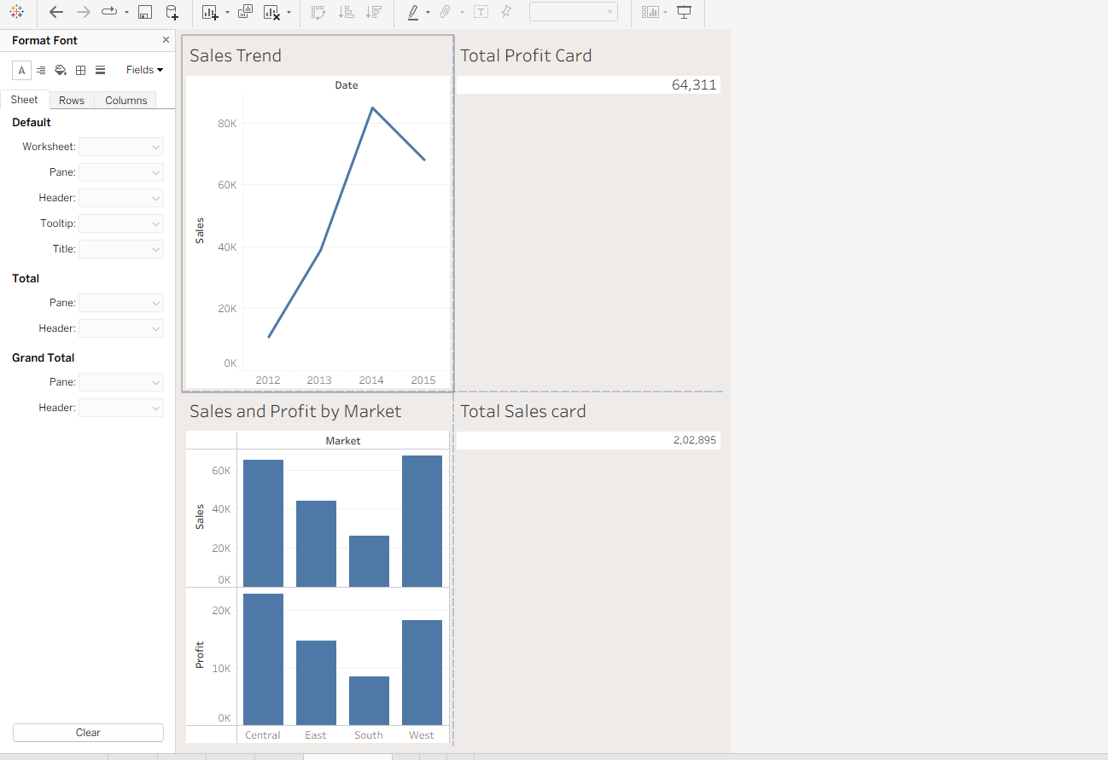
Dashboard

Slide 9
Dashboard

Slide 10
Summary
The business has achieved total sales of 202,895 and total profit of 64,311 over the observed period.
Performance peaked in 2014 and declined slightly in 2015.
Central and West markets are driving most of the performance, while South needs attention for improvement.

Slide 11
THANK YOU

